Slide 1

Secrets of Conflict Resolution
Chad Green
Director of IT Architecture
Glennis Solutions
Level: Introductory

Slide 2

Session Survey
Your feedback is very important to us
Please take a moment to complete the session survey found in the mobile app
Use the QR code or search for “Converge360 Events” in your app store
Find this session on the Agenda tab
Click “Session Evaluation”
Thank you!

Slide 3







Who is Chad Green
chadgreen@chadgreen.com
TaleLearnCode
ChadGreen.com
ChadGreen & TaleLearnCode
ChadwickEGreen

Slide 4








Who is Chad Green
IT Architecture Director
President / Conference Chair
Director of Software Development
Data & Solutions Architect
Service Delivery Manager
Project Manager
Technical Lead
Consultant
Programmer/Analyst
Programmer
Aircraft Maintenance Administration Specialist

Slide 5
Agenda
What is Conflict and Conflict Resolution
Common Approaches to Conflict Resolution
Understanding Group Dynamics
Tips for Managing Conflict

Slide 6

What is conflict?

Slide 7



What is conflict?
Good discussion about the possibilities
Not bad, but not good
Things starting to fall apart
Notes:
Hopefully, your team conversations are something like what this picture depicts. This is a good discussion about the possibilities. As the project lead, tech leader, architect, or whatever, you help your team come to sound conclusions using useful conversation tools.
<CLICK>
Team members can become very entrenched in their ideas, and your team conversation might be more like this. This is alright, but too many meetings like this will wear down your team.
It is here where we can genuinely start seeing conflict. You can see the poor guy in the middle thinking, “Oh my goodness, are we really going to do this again?”
<CLICK>
Unfortunately, conversations can get more heated and look like this. Here you can see where things are starting to fall apart.
We have all probably been in a conversation that looked like this. Hopefully, when you were in such a situation, someone could employ conflict resolution to get you back to the first image.

Slide 8
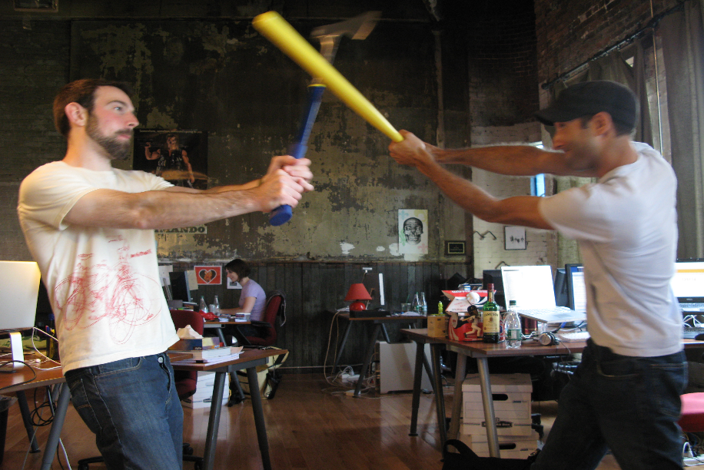
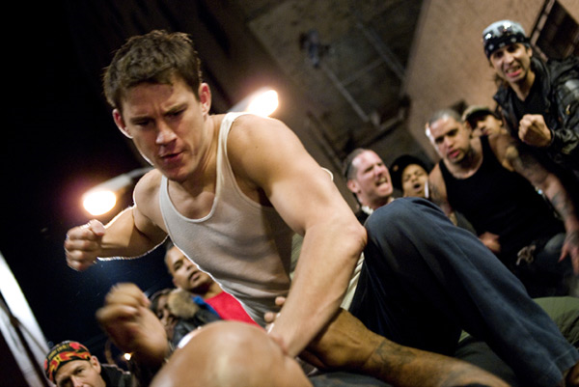
What is conflict?
Oh goodness, this cannot be good
Now this is
really serious
Notes:
Now hopefully, your team meetings do not come to this. Obviously, things have gotten off the rails, and even if someone is not physically hurt, there will be deep wounds on the team. But, of course, it could get worse.
Now in all seriousness, you’ll probably never see more than the images on the previous slide. But not addressing conflict early could result in something more serious.

Slide 9


Slide 10
Workplace Conflict
85% of US employees experience conflict and spend 2.8 hours per week dealing with it
85%
$359
Significant loss of organization productivity costs $359 billion a year
27%
25%
27% of employees witnessed personal attacks
25% say avoiding conflict results in sickness/absences
31%
78%
31% of managers think they handle conflict effectively
78% of employees disagree
95% of those who receive training say it is the biggest driver for success
95%
60%
Nearly 60% have never received training
Notes:
It’s pretty rare to work in an organization without conflict or strife.
Surveys show us that 85% of U.S. employees have experience conflict and spend 2.8 hours per week dealing with it.
This causes a significant loss of organizational productivity, costing companies $359 billion a year in lost productivity. Think about that for a second. Every year, companies lose $359 billion in productivity because employees have difficulty getting along. That represents 2% of the United States’ gross domestic product and would rank 31st in the International Monetary Fund’s list of countries by GDP. That is more than the bottom 70 countries produced in 2015.
But along with those numbers, 27% of employees witnessed personal attacks.
And 25% say avoiding conflict results in sickness and/or absences. That shows evidence that we need to address conflict within the workplace.
Interestingly, 31% of managers think that they handle conflict effectively.
While 78% of employees do not think their managers handle conflict effectively.
The silver lining is that 95% of those who receive training say it is the biggest driver for success. This means there are ways to improve the situation; we need to train people.
And there is the rub, as nearly 60% have NEVER received training.
One last number I want to share. I have shown that conflict costs companies lost productivity and other associated costs with that conflict. But conflict is also a necessary evil.

Slide 11
Workplace Conflict
75%
75% of employees report positive outcomes from conflict that would have not been realized without conflict
Notes:
75% of employees report positive outcomes from conflict that would NOT have been realized with some form of conflict.

Slide 12

What is Conflict Resolution
Notes:
So what is conflict resolution?
Well let me start with the story about a man who left his three sons 17 camels.

Slide 13

What is Conflict Resolution
Notes:
To the first son, he left half of the camels. The second was to receive a third of the camels. And the youngest was going to get a ninth of the camels.
Well the three sons get into a negotiation and 17 camels do not divide into two, doesn’t divide by three, and it doesn’t divide by nine. Tempers start to flare and in desperation they went and consulted a wise old woman.

Slide 14

What is Conflict Resolution
Notes:
This wise old woman thought about their problem for some time and finally said that since she could no longer ride her camel that she would give them the camel.

Slide 15

What is Conflict Resolution
Notes:
So now they had 18 camels. The first son took his half

Slide 16
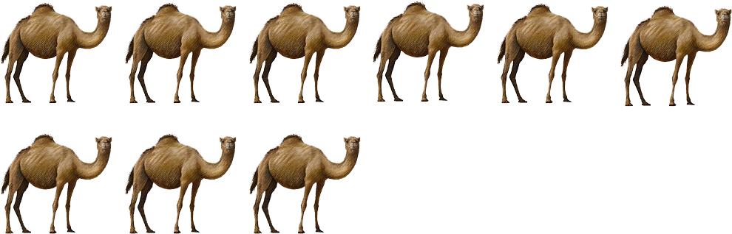
What is Conflict Resolution
Notes:
Half of 18 is 9.
The second soon took his third

Slide 17

What is Conflict Resolution
Notes:
A third of 18 is 6.
And the youngest son took his ninth

Slide 18

What is Conflict Resolution
Notes:
A ninth of 18 is 2
Low and behold,

Slide 19

What is Conflict Resolution
Notes:
There is a camel left over.
They were able to

Slide 20

What is Conflict Resolution
Notes:
Give the old woman back her camel.
Now if you think about this story for a moment, you will see it resembles a lot of the difficult negotiations we get involved with. They start off like 17 camels with no way to resolve the problem, but somehow, we need to take a step back from the situations – like what the wise old woman did – and look at the situations through fresh eyes and come up with the 18th camel.

Slide 21
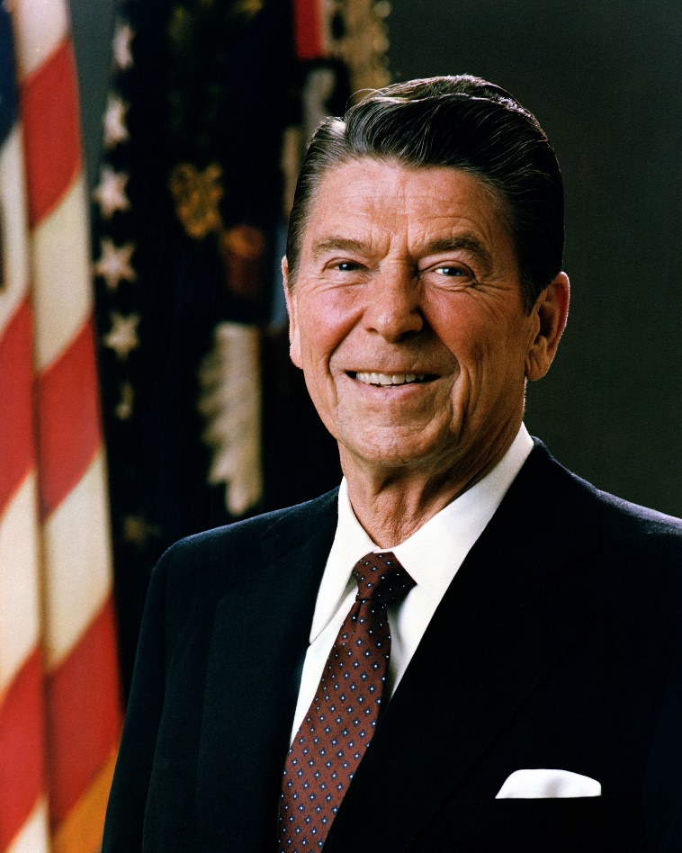
Peace is not the absence of conflict, it is the ability to handle conflict by peaceful means.
Ronald Reagan

Slide 22
Approaches to Conflict Resolution
Secrets of Conflict Resolution
Notes:
An appreciation of conflict resolution approaches is integral to understanding the communication process. While the names may differ slightly, there are five major responsive approaches to managing conflict. There is no right or wrong conflict resolution approach, and each conflict participant can choose the most appropriate method in a given situation. A leader should understand these approaches in the workplace to help parties resolve conflicts.

Slide 23

Collaboration
Problem Solving
Confronting
Integrating
Notes:
The first approach we are going to look at is Collaboration which is also referred to as problem solving, confronting, and integrating.

Slide 24

Collaboration
Collaboration
Multiple viewpoints and insights from different perspectives
Notes:
PMI defines collaboration as incorporating multiple viewpoints and insights from different perspectives.
In this technique, the parties openly discuss differences and incorporate multiple viewpoints to reach a consensus.

Slide 25

Collaboration
Collaboration
Multiple viewpoints and insights from different perspectives
Rational problem solving
Notes:
This approach involves a rational problem-solving approach. More succinctly, this approach has disputing parties solve their differences first.

Slide 26
Collaboration
Collaboration
Multiple viewpoints and insights from different perspectives
Rational problem solving
Focusing on the issues
Notes:
focusing on the issues, then

Slide 27
Collaboration
Collaboration
Multiple viewpoints and insights from different perspectives
Rational problem solving
Focusing on the issues
Looking at alternative approaches
Notes:
looking at alternative approaches, and finally

Slide 28
Collaboration
Collaboration
Multiple viewpoints and insights from different perspectives
Rational problem solving
Focusing on the issues
Looking at alternative approaches
Selecting best alternative
Notes:
selecting the best alternative.
This approach involves open and direct communication, which should lead the way to solve the problem at hand.

Slide 29
Collaboration
Win/Win
Collaboration
Multiple viewpoints and insights from different perspectives
Rational problem solving
Focusing on the issues
Looking at alternative approaches
Selecting best alternative
Notes:
As such, this is considered to be a win-win approach.
So, what are examples of when collaborating maybe appropriate?

Slide 30

Collaboration
When to use?
Consensus and commitment is important
Notes:
The whole point of collaboration is getting consensus with everyone, so obviously, an excellent time to use is when agreement and commitment of all parties are essential.
If done correctly, you will have a win-win solution.

Slide 31

Collaboration
When to use?
Consensus and commitment is important
Collaborative environment
Notes:
Obviously, when working in a collaborative environment

Slide 32
Collaboration
When to use?
Consensus and commitment is important
Collaborative environment
Address interest of multiple stakeholders
Notes:
If you need to address the interest of more than one stakeholder, then collaborating will be the way to go – Army ROTC example.

Slide 33
Collaboration
When to use?
Consensus and commitment is important
Collaborative environment
Address interest of multiple stakeholders
High level of trust is present
Notes:
To trust is to have faith in the honesty, integrity, reliability, and competence of another. Trust is essential in collaboration.

Slide 34
Collaboration
When to use?
Consensus and commitment is important
Collaborative environment
Address interest of multiple stakeholders
High level of trust is present
Long-term relationship is important
Notes:
Hand-in-hand with trust is long-term relationships. Collaboration helps continue trust between parties.

Slide 35
Collaboration
When to use?
Consensus and commitment is important
Collaborative environment
Address interest of multiple stakeholders
High level of trust is present
Long-term relationship is important
Work through hard feelings, animosity, etc.
Notes:
Need to work through hard feelings, animosity, etc. Even a group that has worked well with each other will have some strife. Because collaborating involves focusing on issues TOGETHER and selecting the best alternative TOGETHER, it is a good approach.

Slide 36
Collaboration
When to use?
Consensus and commitment is important
Collaborative environment
Address interest of multiple stakeholders
High level of trust is present
Long-term relationship is important
Work through hard feelings, animosity, etc.
Do not want full responsibility
Notes:
When you want to avoid having full responsibility. Example: project manager working with developers on tech issues

Slide 37
Collaboration
Advantages
Solves the actual problem
Notes:
So now that we have looked at when is a good time to use the collaboration approach, let’s look at some of its advantages.
First and foremost, the collaboration approach leads to solving the actual problem.
You are discussing what the issue is and alternatives to the solution, which, by doing so, will allow you to solve the actual problem at hand. However, as you will see with some of the other approaches, you are not necessarily solving the problem that caused the conflict.

Slide 38
Collaboration
Advantages
Solves the actual problem
Win-Win outcome
Notes:
Because you are getting all sides to agree with the solution, you get a win-win outcome.

Slide 39
Collaboration
Advantages
Solves the actual problem
Win-Win outcome
Reinforces mutual trust and respect
Notes:
Because all sides work together, collaboration promotes mutual trust and respect among the different parties.

Slide 40
Collaboration
Advantages
Solves the actual problem
Win-Win outcome
Reinforces mutual trust and respect
Foundation for effective collaboration
Notes:
The collaboration approach will provide a solid foundation for effective collaboration in the future.

Slide 41
Collaboration
Advantages
Solves the actual problem
Win-Win outcome
Reinforces mutual trust and respect
Foundation for effective collaboration
Shared responsibility
Notes:
There is a shared responsibility for the resulting outcome.

Slide 42
Collaboration
Advantages
Solves the actual problem
Win-Win outcome
Reinforces mutual trust and respect
Foundation for effective collaboration
Shared responsibility
Earn the reputation of good negotiator
Notes:
One moderating will get the reputation of a good negotiator and encourage future cooperation.

Slide 43
Collaboration
Advantages
Solves the actual problem
Win-Win outcome
Reinforces mutual trust and respect
Foundation for effective collaboration
Shared responsibility
Earn the reputation of good negotiator
Outcome is less stressful
Notes:
As a general rule, the outcome will be less stressful.
Those are some fantastic advantages, but what about the disadvantages?

Slide 44
Collaboration
Disadvantages
Requires commitment from all parties
Notes:
Requires a commitment from all parties.

Slide 45
Collaboration
Disadvantages
Requires commitment from all parties
May require more effort and time
Notes:
Reviewing the issue and then looking at alternative solutions may require more time and effort.

Slide 46
Collaboration
Disadvantages
Requires commitment from all parties
May require more effort and time
Not practical when timing is critical
Notes:
It may not be practical when the timing is crucial; managing an e-commerce app with an outage 2-hours before a massive Black Friday sale.

Slide 47
Collaboration
Disadvantages
Requires commitment from all parties
May require more effort and time
Not practical when timing is critical
Must continue collaborative efforts
Notes:
Collaboration requires that involved parties must continue collaborative efforts to maintain a cooperative relationship.

Slide 48

Compromise
Give and take
Reconciling
Notes:
Next, we have the Compromise approach. This is also referred to as a “give and take” approach or reconciling.

Slide 49

Compromise
Bargain to reach a mutually acceptable solution
Notes:
With this approach, conflicting parties bargain to reach a mutually acceptable solution. As a result, both parties give up something to make a decision and leave with some degree of satisfaction.

Slide 50
Compromise
Bargain to reach a mutually acceptable solution
Lose/Lose
Notes:
This is considered a lose-lose situation since no party gets everything they want.
So why would you use the compromising approach? Well, because sometimes a lose-lose situation is what the doctor calls for.

Slide 51

Compromise
When to Use?
Both parties need to win
Notes:
If sold right, this can look as if post parties win and there are times where that is just the case. Examples 2 weeks/4 weeks.

Slide 52

Compromise
When to Use?
Both parties need to win
Goals are moderately important
Notes:
Goals are only moderately important and not worth the use of a more assertive or more involved approaches

Slide 53
Compromise
When to Use?
Both parties need to win
Goals are moderately important
Temporary settlement on complex issues
Notes:
You may need an expedient solution on a complex issue where you do not have time to make a more elaborate approach. Again, think back to the e-commerce example.

Slide 54
Compromise
When to Use?
Both parties need to win
Goals are moderately important
Temporary settlement on complex issues
Expedient solutions on important issues
Notes:
Maybe you need an expedient solution to a complex issue where you do not have time to make a more elaborate approach. Think back to the e-commerce example.

Slide 55
Compromise
When to Use?
Both parties need to win
Goals are moderately important
Temporary settlement on complex issues
Expedient solutions on important issues
Involved parties do not know each other
Notes:
Collaboration pretty much requires relationships; compromising can work better with parties that do not know each other.

Slide 56
Compromise
When to Use?
Both parties need to win
Goals are moderately important
Temporary settlement on complex issues
Expedient solutions on important issues
Involved parties do not know each other
Collaboration or forcing does not work
Notes:
When collaboration or force does not work.

Slide 57
Compromise
Advantages
Faster issue resolution
Notes:
It will generally generate a faster resolution to your issue. In addition, because you are not looking at the root of the problems and doing analysis like you would with collaboration, this approach should produce faster results than other approaches.

Slide 58
Compromise
Advantages
Faster issue resolution
Provides a temporary solution
Notes:
Can provide a temporary solution while looking for a win-win solution.

Slide 59
Compromise
Advantages
Faster issue resolution
Provides a temporary solution
Lowers tension and stress
Notes:
Lowers the level of tension and stress resulting from the conflict.

Slide 60
Compromise
Disadvantages
Both parties are not satisfied
Notes:
Both parties are still looking for more.

Slide 61
Compromise
Disadvantages
Both parties are not satisfied
Does not build trust
Notes:
Using the compromise approach does not contribute to building trust in the long run.
Both sides tend to think that they gave up too much, so trust Is not built up.

Slide 62
Compromise
Disadvantages
Both parties are not satisfied
Does not build trust
Close monitoring and control
Notes:
It may require close monitoring and control to ensure agreements are met.

Slide 63

Accommodation
Smoothing
Obliging
Notes:
Next, we have Accommodation which is also referred to as smoothing or obliging.

Slide 64

Accommodation
Areas of agreement are emphasized
Areas of disagreement are downplayed
Lose/Win
Notes:
In this approach, the areas of agreement are emphasized, and the areas of disagreement are downplayed. The approach emphasized cooperation instead of assertiveness. A person places their interest last and allows the other party to further their interests. The accommodation approach often occurs when a party is not significantly invested in securing a victory because they need to perceive the alternative option as a significant threat.
Simply put, this approach accommodates the concerns of other people first rather than one’s own concerns. This technique emphasizes agreement rather than differences of opinion.
Here’s an analogy to explain accommodation: When driving in traffic, I often see someone playing a zero-sum game, for whom their objective in life is to get ahead of you – at all costs – regardless of who has the right of way. A lot of times, if I detect an aggressive driver like this, I will slow down and let the other person get in front of me because, in reality, I am not playing the same games as the other driver. My objective is to keep traffic flowing smoothly and not be in a Fast and Furious outtake and end up in the hospital – or worse!

Slide 65

Accommodation
When to use?
Provide a temporary relief or buy time
Notes:
Necessary to provide temporary relief from a conflict or buy time until you are in a better to respond or push back

Slide 66

Accommodation
When to use?
Provide a temporary relief or buy time
Issue not as important to you
Notes:
When the issue is not as important to you as the other person. Think about the analogy of the other driver that just had to get in front of me.

Slide 67
Accommodation
When to use?
Provide a temporary relief or buy time
Issue not as important to you
You accept you are wrong
Notes:
When you accept, you are wrong. Saying: sometimes you must shut up, swallow your pride, and get that you are wrong. It’s not giving up; it’s called growing up.

Slide 68
Accommodation
When to use?
Provide a temporary relief or buy time
Issue not as important to you
You accept you are wrong
You have no choice/continued competition would be detrimental
Notes:
When you have no choice or when continued competition would be detrimental.

Slide 69
Accommodation
Advantages
Protects more important interest
Notes:
In some cases, accommodation will help to protect more critical interests while giving up on some less important ones. Someone will lose something, but if what is being lost is less important than what is gained, there is a significant benefit to gaining that big advantage. Go back to my driving analogy.

Slide 70
Accommodation
Advantages
Protects more important interest
Opportunity to reassess the situation
Notes:
Allows for reassessing the situation from a different angle. This is especially true when resolving a conflict you are directly involved in. By giving up what you want and letting the other get what they want, you will be in an excellent position to see the situation from the other person’s perspective.

Slide 71
Accommodation
Disadvantages
More difficult to transition to win-win
Notes:
Accommodating makes it more challenging to transition to a win-win solution in the future. While not always possible, we all wish to get a win-win solution. Still, the accommodation approach provides a lose-win solution – someone has to “lose” for the accommodation approach to be successful. So let’s say you have used the accommodation approach to get a temporary solution to get work done with the thought that after an important deadline, you will go back and work on a win-win solution using maybe the collaboration approach.
Or you realized what is better is a lose/lose solution because, in the end, that is what is better for the team, so you want to use the comprise approach. Well, once one side has won, it will be much harder to get the winner back to the table and possibly “lose” what they have already “won.”

Slide 72
Accommodation
Disadvantages
More difficult to transition to win-win
Some supporters may not like your response
Notes:
Some of your supporters may not like your accommodation response and be turned off.
I have seen it personally where I used accommodation because I needed a quick solution so my team could get back to what is essential – work – and I will see where others not involved did not like my response. This is especially true for my project managers as they might not like that someone won while someone lost, or more importantly, they might not like WHO won.
Now when this does happen, you have to work it out with those supporters so that they understand why you want to go down one path instead of another.

Slide 73

Force
Directing
Competing
Controlling
Dominating
Notes:
Force – also known as directing, competing, controlling, or dominating.

Slide 74

Force
Pushing viewpoint at expense of another
Notes:
This technique involves pushing one's viewpoint at the expense of another and will generate a win-lose solution. When using this approach, an individual firmly pushes their own concerns despite the other person's resistance.

Slide 75

Force
Pushing viewpoint at expense of another
Assertiveness is hallmark
Notes:
Assertiveness is the hallmark of this approach and those employing this approach.

Slide 76
Force
Pushing viewpoint at expense of another
Assertiveness is hallmark
Addresses conflict head-on
Notes:
When using this approach, you aim to address the conflict head-on. It might involve high emotions as the parties establish positions in what can sometimes evolve into hostile communications.

Slide 77
Force
Pushing viewpoint at expense of another
Assertiveness is hallmark
Addresses conflict head-on
Win/Lose

Slide 78

Force
When to use?
Other methods do not work
Notes:
So when do we use such a "forceful" approach?
The apparent time is when all other, less forceful methods do not work or are ineffective. For example, suppose you have worked long on the complex to get collaboration, compromise, or even accommodation to work but have yet to be successful. In that case, you will likely have to resort to using the Force approach to resolve the conflict and get people back working.

Slide 79

Force
When to use?
Other methods do not work
Stand up for your rights
Notes:
You need to stand up for your rights and resist aggression and pressure from others. But, as leaders, there are times when we need to assert our professional needs over others.
Generally, you have become a leader because you are a trusted professional, earned the right, and have the experience to be correct. But be careful when using this approach when standing up for yourself, as perception can quickly change, and you are viewed as a dictator.

Slide 80
Force
When to use?
Other methods do not work
Stand up for your rights
Quick resolution is required
Notes:
When a quick resolution is required and using force is justified. For example, you might use the force approach in a life-threatening situation or stop aggression.

Slide 81
Force
When to use?
Other methods do not work
Stand up for your rights
Quick resolution is required
Last resort to long-lasting conflict
Notes:
As a last resort to resolve a long-lasting conflict. Maybe you have entered a conflict that has been going on for a long time, and if that conflict continues, it could be detrimental to the project or people’s healthy beings. Well, then, maybe you need to start with the force approach to resolving that conflict that has been going on for a long time.

Slide 82

Force
Advantages
Quick resolution
Notes:
It may provide a quick resolution to a conflict. There is not a lot of back-and-forth discussion from the different sides – actually, there might not be any discussion – so this approach tends to generate results pretty quickly.

Slide 83

Force
Advantages
Quick resolution
Increases self-esteem/respect
Notes:
It will increase self-esteem and draw respect when the action responds to aggression or hostility. The self-esteem part is evident since the one using the technique gets what the enactor wants. But you might say that even if you get some respect by using this approach, that respect is probably short-lived. Well, that can be the case, but only sometimes. Example of Ferdinand Marcos – 1986 uprising.

Slide 84
Force
Disadvantages
Negatively affect relationship
Notes:
It may negatively affect your relationship with the opponent in the long run. Just like in my example with President Marcos, he continued to use the force approach, and it caused strife among the people to the point that there was a public demonstration and the city of Manila was overrun by the opposition. So you must be careful when using this approach to avoid becoming a dictator.

Slide 85
Force
Disadvantages
Negatively affect relationship
Opponent reacts in same way
Notes:
This may cause the opponent to react the same way, even if the opponent did not intend to be forceful initially. The concept of the flight-or-fight response is a physiological reaction that occurs in response to a perceived harmful event, attack, or threat to survival. While some might fly away from future conflict, others will see this as a threat to their survival and might retaliate back using the same approach to you.

Slide 86
Force
Disadvantages
Negatively affect relationship
Opponent reacts in same way
Lots of energy
Notes:
It may require a lot of energy and be exhausting to some individuals. Using something like the accommodation approach to resolve conflict can be much easier. However, because there can be some resistance – at least at first – this can be tiring to the one enacting the technique.

Slide 87
Force
Disadvantages
Negatively affect relationship
Opponent reacts in same way
Lots of energy
Cannot take advantage of other side’s position
Notes:
Actually, more critical in my mind is that using the force approach does not take advantage of the strong points of the other side’s position. You are probably not even listening to what the other side says. And if you do, you are not taking advantage of their solutions.

Slide 88

Withdrawal
Avoidance
Notes:
Finally we have the Withdrawal approach, which is also known as avoidance.

Slide 89

Withdrawal
Retreat or postpone a decision on a problem
Notes:
In this technique, the parties retreat or postpone a decision on a problem.

Slide 90

Withdrawal
Retreat or postpone a decision on a problem
Not best choice for resolving conflict
Notes:
Dealing with problems is a PMI-ism; therefore, withdrawal is usually not the best choice for resolving conflict, though there may be situations where it is necessary.

Slide 91
Withdrawal
Retreat or postpone a decision on a problem
Not best choice for resolving conflict
Not giving up – sidestepping or postponing
Notes:
Note that this is not giving up; it’s just sidestepping or postponing the issue.

Slide 92

Withdrawal
When to use?
Trivial issue not worth effort
Notes:
Well, there are more times than you would think, and I’m not including it because you are lazy – which would be a lousy reason to withdraw from a conflict.
The issue is trivial and not worth the effort. Conflict comes in all shapes and sizes; some will not warrant your attention.

Slide 93

Withdrawal
When to use?
Trivial issue not worth effort
More important pressing issues
Notes:
When more important issues are pressing, you do not have time to deal with them.
Again, if you are a leader, you live a busy life and need more time to get into every little conflict.

Slide 94
Withdrawal
When to use?
Trivial issue not worth effort
More important pressing issues
postponing response is beneficial
Notes:
In situations where postponing the response is beneficial to you. For example, there might be better times or places to confront the issue, or you need more time to think and collect information before you act. This is a common use of the withdrawal approach – or at least it should be.
Example of technical debt.

Slide 95
Withdrawal
When to use?
Trivial issue not worth effort
More important pressing issues
postponing response is beneficial
No chance of getting concerns met
Notes:
When you see no chance of meeting your concerns, you would have to put forth unreasonable efforts.

Slide 96
Withdrawal
When to use?
Trivial issue not worth effort
More important pressing issues
postponing response is beneficial
No chance of getting concerns met
Have to deal with hostility
Notes:
There are times when the appropriate solution would cause hostility, and you need to avoid that, so using the withdrawal approach would make sense there.

Slide 97
Withdrawal
When to use?
Trivial issue not worth effort
More important pressing issues
postponing response is beneficial
No chance of getting concerns met
Have to deal with hostility
Unable to handle conflict
Notes:
When you cannot handle the conflict, such as when you are too emotionally involved, another can handle it better. If you are emotionally involved, it’s probably better to take a step back and let someone else come in.

Slide 98
Withdrawal
Advantages
Postpone until more favorable circumstance
Notes:
When the opponent is forcing or attempting aggression, you may withdraw and postpone your response until you are in more favorable circumstances to push back.

Slide 99
Withdrawal
Advantages
Postpone until more favorable circumstance
Low stress approach
Notes:
Withdrawing is a low-stress approach when the conflict is short. But, of course, there are times when we see that the conflict will be short, so instead of creating a bunch of stress trying to solve the conflict, the withdrawal approach provides a way to lower the tension all around.

Slide 100
Withdrawal
Advantages
Postpone until more favorable circumstance
Low stress approach
Ability/time to focus on more important/urgent issues
Notes:
The withdrawal approach gives you the ability and time to focus on more important or urgent issues instead. As I have said, you will have all sorts of conflicts come your way, and they all deserve a different level of attention.

Slide 101
Withdrawal
Advantages
Postpone until more favorable circumstance
Low stress approach
Ability/time to focus on more important/urgent issues
Time to be better prepared
Notes:
The withdrawal approach gives you time to prepare and collect information before acting.

Slide 102
Withdrawal
Disadvantages
Lead to weaking or losing position
Notes:
The most significant disadvantage is that using this technique may weaken or lose your position; not acting may be interpreted as an agreement. Using withdrawing strategies without negatively affecting your position requires particular skill and experience. You do not want to be considered weak, as you will no longer be a leader.

Slide 103
Withdrawal
Disadvantages
Lead to weaking or losing position
Interpreted as agreement
Notes:
Withdrawal can easily be interpreted as agreement.

Slide 104
Withdrawal
Disadvantages
Lead to weaking or losing position
Interpreted as agreement
Negatively affect relationship with others
Notes:
When multiple parties are involved, withdrawing may negatively affect your relationship with a party that expects your action. For example, in my role, I see conflicts between developers and project managers, and there are times when if I do not act – even though it might be in my or the team’s best interest - it can cause one of those sides to feel slighted by my “lack” of action.

Slide 105
Exercise
Secrets of Conflict Resolution

Slide 106
Exercise
“Do it my way!”
Force

Slide 107
Exercise
“Let’s calm down and get the job done!”
Accommodation

Slide 108
Exercise
“Let us do a little of what both of you suggest.”
Compromise

Slide 109
Exercise
“Let’s deal with this issue next week.”
Withdrawal

Slide 110
Exercise
“Pat and Amanda, both of you want this project to cause as little distraction to your departments as possible. With that in mind, I am sure we can come to be agreement on the purchase of equipment and what is best for the project.”
Accommodation

Slide 111
Exercise
“We have talked about new computers enough. I do not want to get the computers, and that it is!”
Force

Slide 112
Exercise
“Pat, you say the project should include the purchase of new computers, and Amanda, you say the project can use existing equipment. I suggest we perform the following test on the existing equipment to determine if it needs to be replaced.”
Collaboration

Slide 113
Exercise
“Let’s see what everyone thinks, and try to reach a consensus.”
Collaboration

Slide 114
Exercise
“Since we cannot decide on the purchase of new computers, we will have to wait until our meeting next month.”
Withdrawal

Slide 115
Exercise
“Pat, what if we get new computers for the design activity on the project and use the existing computers for the monitoring functions?”
Compromise

Slide 116
Understanding Group Dynamics
Secrets of Conflict Resolution

Slide 117
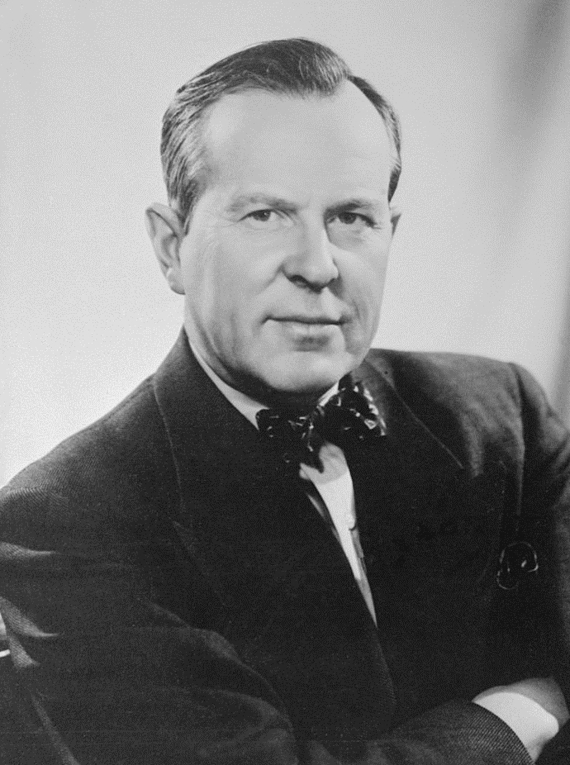
How can there be peace without people understanding each other; and how can this be if they don’t know each other?
Lester B. Pearson
Notes:
It is hard to resolve conflict among groups of people if you do not understand how people work and group dynamics.
Transactional analysis is a psychoanalytic therapy wherein social transactions are analyzed to determine the ego state of the patient as a basis for understanding behavior. As I only have an hour, I’m not going deep into psychoanalysis, but I will discuss an important tool within this type of analysis.

Slide 118

Group Dynamics
Karpman Drama Triangle
Notes:
Conflict has a predictable pattern known as the drama triangle, which was first introduced by Dr. Steven Karpman. The basic concept underpinning the Karpman Drama Triangle is the connection between responsibility and power and the destructive and shifting roles people play.

Slide 119
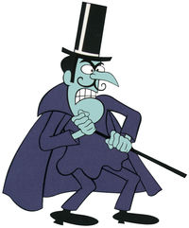
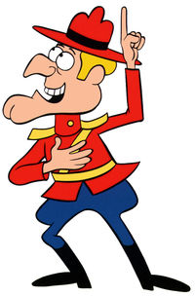

Karpman Drama Triangle
Karpman Drama Triangle
Persecutor
Rescuer
Victim
Notes:
He defined three roles in conflict, Persecutor, Rescuer, and Victim, and placed them on an inverted triangle and referred to them as the three aspects (or faces) of drama. He was interested in acting and chose the term “drama triangle” rather than the term “conflict triangle,” as the Victim in his model is not intended to represent an actual victim. Still, instead, someone is feeling or acting like a victim.
So, let’s take a quick look at these roles.

Slide 120
Karpman Drama Triangle
Persecutor
Rescuer
Victim
Notes:
The Persecutor insists, “It’s all your fault.” The Persecutor is controlling, blaming, critical, oppressive, angry, authoritative, rigid, and superior.
The Rescuer’s line is, “Let me help you.” A classic enabler, the Rescuer feels guilty if they do not go to the rescue.
Yet their rescuing has adverse effects as it keeps the Victim dependent and gives the Victim permission to fail.
The Victim’s stance is, “Poor is me!” The Victim feels victimized, oppressed, helpless, hopeless, powerless, and ashamed, unable to make decisions, solve problems, take pleasure in life, or achieve insight. Therefore, the Victim, if not being persecuted, will seek out a Persecutor and a Rescuer who will save the day and perpetuate the Victim’s negative feelings.

Slide 121
Karpman Drama Triangle
Persecutor
Rescuer
Persecutor
Rescuer
Victim
Victim
Notes:
Initially, a drama triangle arises when a person takes on the role of a victim or persecutor. This person then feels the need to enlist other players in the conflict. These enlisted players take on roles that are not static, so various scenarios can occur. For example, the victim might turn on the rescuer, and the rescuer then switches to persecuting – or, as often happens, a rescuer is encouraged to enter the situation.

Slide 122

Little Red Riding Hood
Karpman Drama Triangle

Slide 123
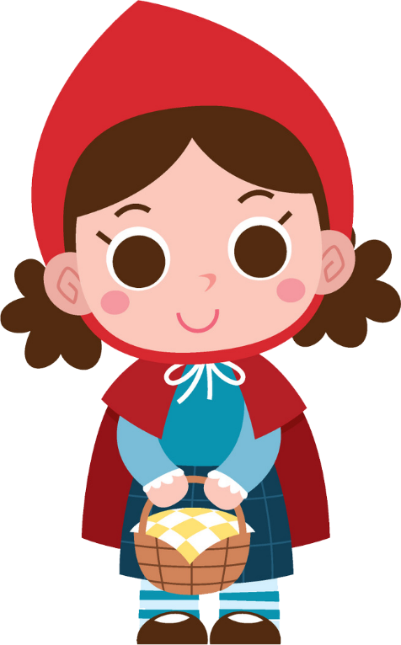
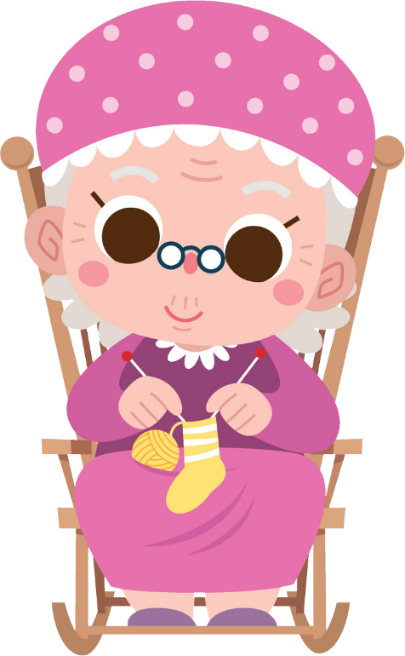
Little Red Riding Hood
Notes:
Once upon a time, there was a little girl loved by everyone who looked at her, but most of all by her grandmother, and there was nothing that she would not have given to the child. Once, she gave her a little cap of red velvet. After that, the girl loved it so much that she would never wear anything else. So, she was always called Little Red Riding Hood.
One day her mother said, "Little Red Riding Hood, here is a piece of cake and a bottle of wine. Take them to your grandmother, who is ill and weak, and they will do her good. Set out before it gets hot, and when you are going, do not go off the path, or you will fall and break the bottle, and your grandmother will get nothing. And when you go into her room, don't forget to say good morning, and don't peek around before you do it."
"I will take great care," said Little Red Riding Hood to her mother, and she took the goods to take her grandmother.

Slide 124

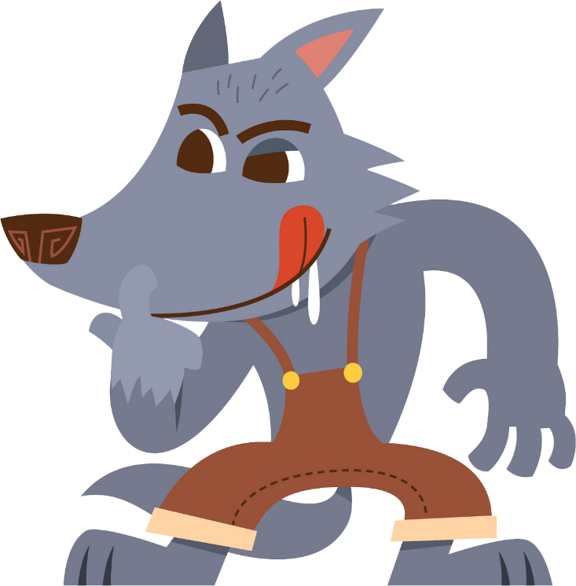
Little Red Riding Hood
Notes:
The grandmother lived out in the woods, about a mile and a half from the village, and just as Little Red Riding Hood entered the woods, a wolf met her. Little Red Riding Hood did not know what a wicked creature he was and was not afraid of him.
“Good day, Little Red Riding Hood,” he said.
“Thank you kindly, wolf.”
“Where are you going so early in the day, Little Red Riding Hood?”
“To my grandmother’s.”
“What have you got in your basket?”
“Cake and wine. Yesterday was baking day, so poor sick grandmother is to have something good to make her stronger.”
“Where does your grandmother live, Little Red Riding Hood?”
“Almost another mile into the wood. Her house stands under the three large oak trees; the nut trees are just below. You surely must know it,” replied Little Red Riding Hood.
The wolf thought to himself, “What a tender young creature. What a nice plump mouthful; she will be better to eat than the old woman. I must act craftily to catch both.” So he walked for a short time by Little Red Riding Hood’s side, and then she said, “See Little Riding Hood, how pretty the flowers are over there. Why do you not look around? I believe, too, that you do not hear how sweetly the little birds are singing. You walk so gravely as if you were going to school while everything else in the woods is merry.”

Slide 125
Little Red Riding Hood
Notes:
The grandmother lived out in the wood, about a mile and a half from the village, and just as Little Red Riding Hood entered the wood, a wolf met her. Little Red Riding Hood did not know what a wicked creature he was and was not afraid of him.
“Good day, Little Red Riding Hood,” he said.
“Thank you kindly, wolf.”
“Where are you going so early in the day, Little Red Riding Hood?”
“To my grandmother’s.”
“What have you got in your basket?”
“Cake and wine. Yesterday was baking day, so poor sick grandmother is to have something good to make her stronger.”
“Where does your grandmother live, Little Red Riding Hood?”
“Almost another mile into the wood. Her house stands under the three large oak trees; the nut trees are just below. You surely must know it,” replied Little Red Riding Hood.
The wolf thought to himself, “What a tender young creature. What a nice plump mouthful; she will be better to eat than the old woman. I must act craftily to catch both.” So he walked for a short time by Liddle Red Riding Hood’s side, and then she said, “See Little Riding Hood, how pretty the flowers are over there. Why do you not look around? I believe, too, that you hear how sweetly the little birds are singing. You walk so gravely as if you were going to school while everything else in the woods is merry.”

Slide 126

Little Red Riding Hood
Notes:
Little Red Riding Hood raised her eyes, and when she saw the sunbeams dancing here and there through the trees and the pretty flowers growing everywhere, she thought, suppose I take grandmother some fresh flowers. That would please her so. It is so early in the day that I shall still get there in good time. And so she ran from the path into the wood to look for flowers. And whenever she had picked one, she fancied an even prettier one farther on and ran after it and so got deeper and deeper into the wood.

Slide 127

Little Red Riding Hood
Notes:
Meanwhile, the wolf ran straight to the grandmother’s house and knocked on the door.
“Who is there?”
“Little Red Riding Hood,” replied the wolf. “She is bringing cake and wine. Open the door.”
“Lift the latch,” called out the grandmother, “I am too weak and cannot get up.”
The wolf lifted the latch, the door sprang open, and without saying a word, he went straight to the grandmother’s bed and devoured her. Then he put on her clothes, dressed in her cap, laid himself in the bed, and drew the curtains.

Slide 128
Little Red Riding Hood
Notes:
Little Red Riding Hood, however, had been running around picking flowers, and when she had gathered so many that could carry no more, she remembered her grandmother and set out on her way to her.

Slide 129
Little Red Riding Hood
Notes:
She was surprised to find the cottage door standing open, and when she entered the room, she had such a strange feeling.
She called out, “Good morning,” but received no answer. So she went to bed and drew back the curtains.

Slide 130
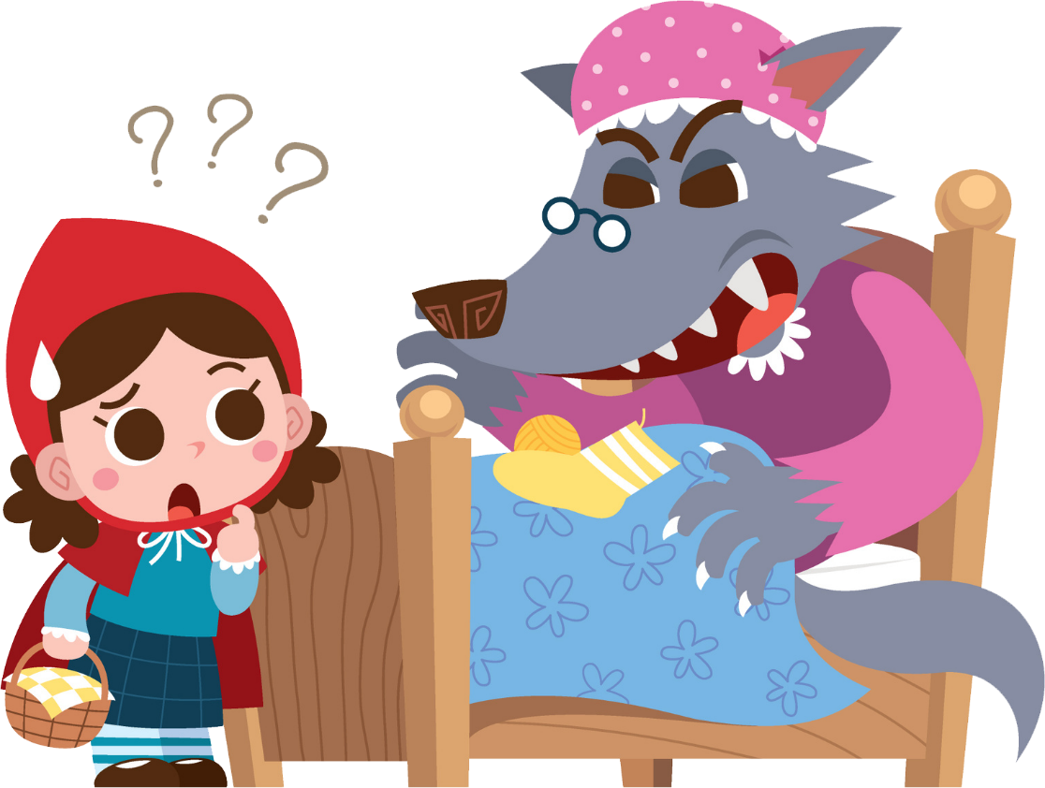
Little Red Riding Hood
Notes:
There lay her grandmother with her cap pulled far over her face and looking very strange.
“Oh, grandmother,” she said, “what big ears you have.”
“The better to hear you with, my child,” was the reply.
“But, grandmother, what big eyes you have,” she said.
“The better to see you with, my dear.”
“But, grandmother, what large hands you have.”
“The better to hug you with.”
“Oh, but, grandmother, what a terrible big mouth you have.”
“The better to eat you with.”
Just as the wolf said this, with one bound, he was out of bed and swallowed up Little Red Riding Hood.
Now that the wolf’s appetite was appeased, he lay down again in the bed, fell asleep, and began to snore very loudly.

Slide 131
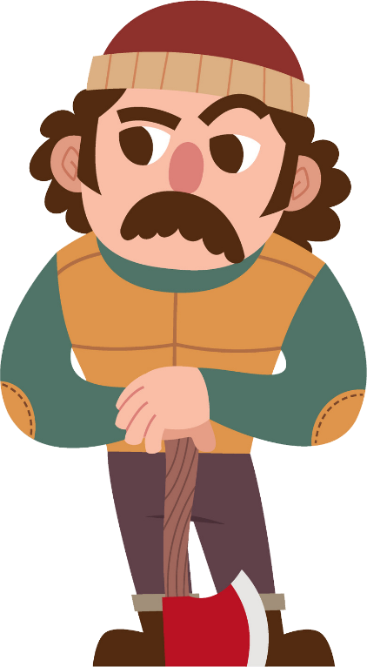

Little Red Riding Hood
Notes:
Just then, the huntsman passed the house and noticed how loud the snoring was. So he thought he should check in on grandmother to see if she needed anything.
So he went inside, and when he came to the bed, he saw the wolf lying in it. “Do I find you here, you old sinner,” he said. “I have long sought you.”

Slide 132
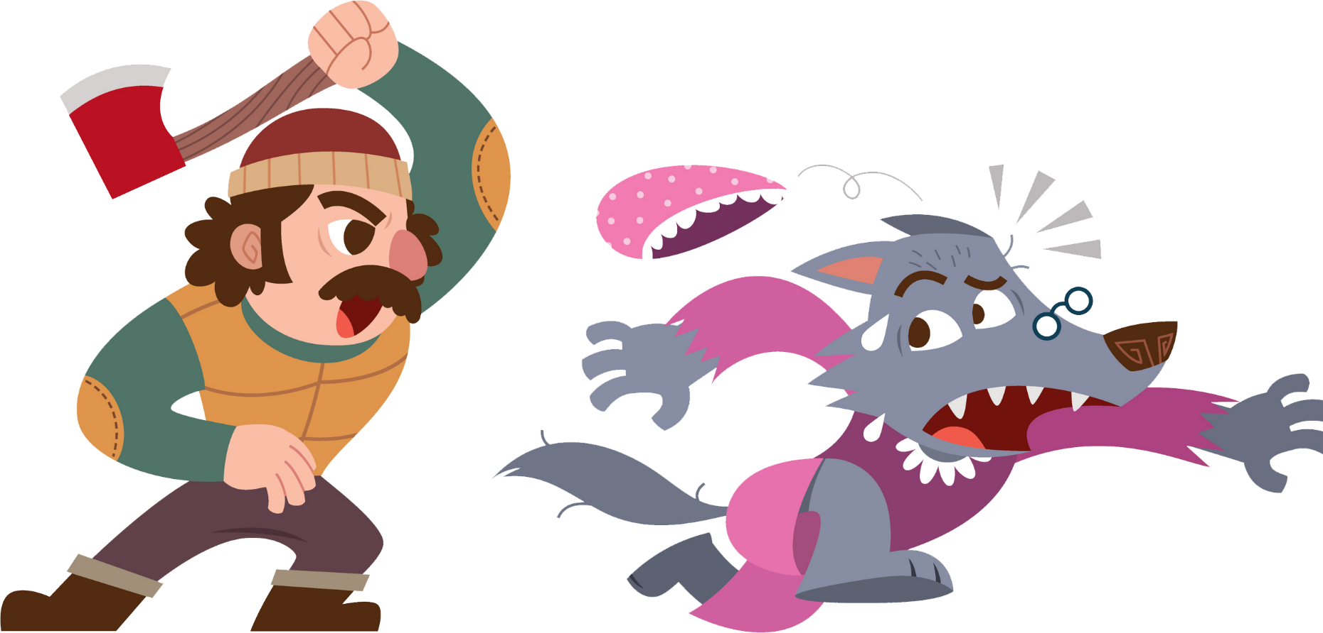
Little Red Riding Hood
Notes:
Just as he was about to fire at the wolf, it occurred to the huntsman that the wolf might have devoured the grandmother and that she might still be saved, so he did not fire.
Instead, he took a pair of scissors and began to cut open the sleeping wolf's stomach.
After making two snipes, he started to see Little Red Riding Hood, and then he made two more snips, and the little girl sprang out. And after that, the aged grandmother came out alive but scarcely able to breathe.
Little Red Riding Hood quickly fetched some stones with which they filled the wolf's belly, and when he awoke, he wanted to run away, but the stones were so heavy that he collapsed at once and fell dead.

Slide 133


Little Red Riding Hood
Notes:
The three were delighted.
The huntsman drew off the wolf’s fur and went home with it. The grandmother ate the cake, drank the wine that Little Red Riding Hood had brought, and was revived. But Little Red Riding Hood thought that as long as she lived, she would never leave the path to run into the wood when her mother had forbidden her to do so.

Slide 134


Little Red Riding Hood - Analysis
Rescuer
Victim
Persecutor
Notes:
In the story, Little Red Riding Hood starts as a Rescuer by taking food and company to her grandmother and providing friendship and directions to the wolf.
In a suspenseful switch, she becomes the Victim of the wolf.
At the end of the story, Little Red Riding Hood winds up as a Persecutor by sewing stones in the wolf’s belly with the woodsman.

Slide 135

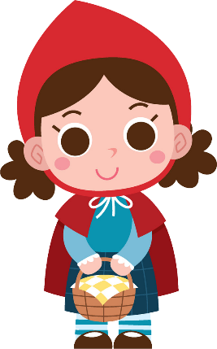
Little Red Riding Hood - Analysis
Persecutor

Slide 136

Little Red Riding Hood - Analysis
Victim

Slide 137



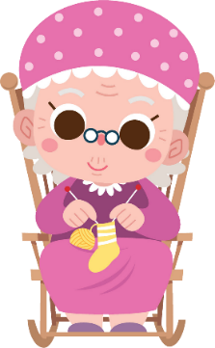
Little Red Riding Hood - Analysis
Persecutor
Rescuer
Notes:
Playing two roles

Slide 138
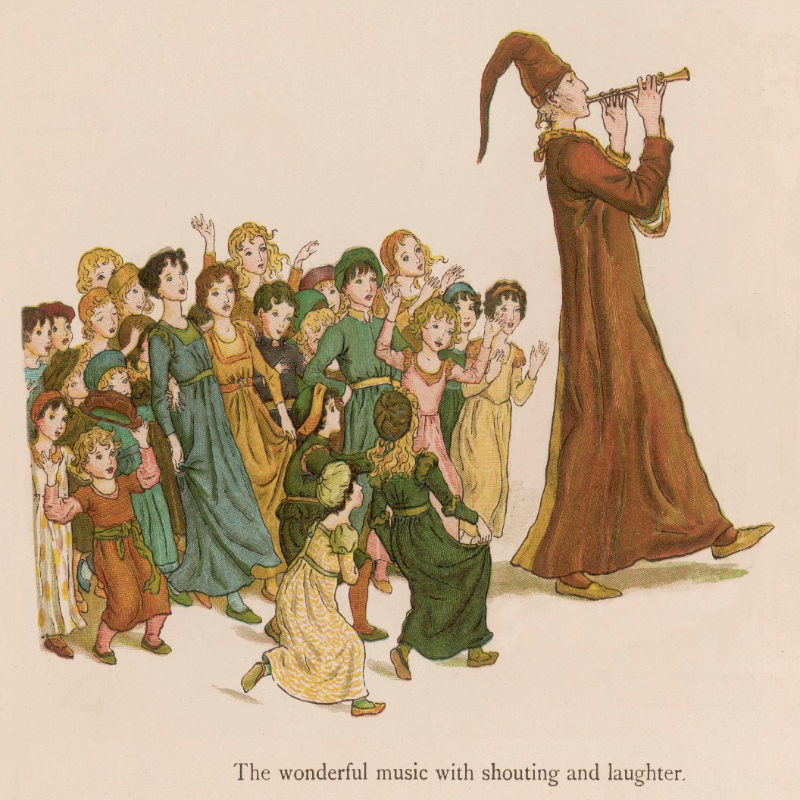
Pied Piper
Karpman Drama Triangle

Slide 139
Pied Piper - Analysis
Pied Piper
Rescuer
Persecutor
Victim
Persecutor
Mayor
Victim
Rescuer
Persecutor
Victim
Children
Persecuted Victim
Rescued Victim
Persecuted Victim
Notes:
In the story, the Pied Piper begins as the Rescuer of the city and the Persecutor of the rates. He then becomes a Victim of the Persecutor mayor’s double-cross (fee withheld) and, in revenge, switches to the Persecutor of the city’s children.
The mayor switches from Victim (of rats), to Rescuer (hiring the Pied Piper), to Persecutor (double-cross), to Victim (his children dead).
The children switch from Persecuted Victims (rates) to Rescued Victims to Victims Persecuted by their Rescuer (increased contrast).

Slide 140
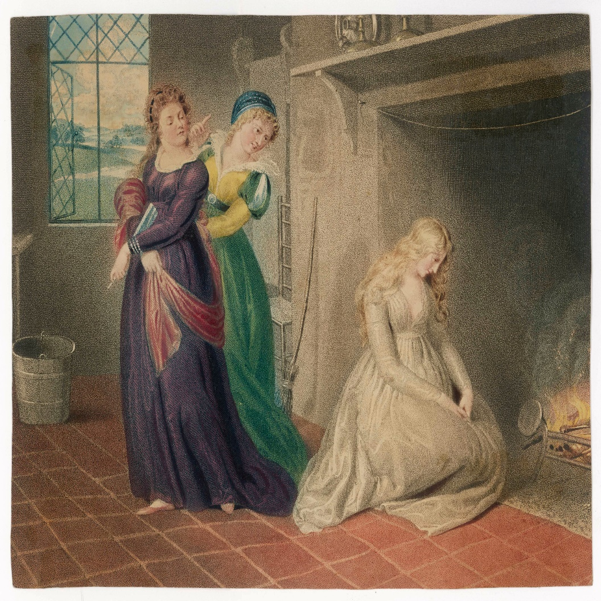
Cinderella
Karpman Drama Triangle

Slide 141
Cinderella - Analysis
Persecuted Victim
Rescued Victim
Persecuted Victim
Rescued Victim
Notes:
In Cinderella, the heroine switched from Victim double Persecuted (mother then stepsisters) to Victim tripled Rescued (Fairy godmother than mice then prince), to Victim Persecuted again (after midnight), then Victim Rescued again.

Slide 142

Software Development Team
Karpman Drama Triangle

Slide 143


Software Development Team Scenario
Bob
Alice
Notes:
A project manager, Bob, is working with a software development team on a new project.
The team is under pressure to meet tight deadlines, and Bob feels stressed and overwhelmed. He notices that one team member, Alice, needs to pull her weight and catch up on her tasks.

Slide 144
Software Development Team Scenario
Drama Triangle
Persecutor
Bob
Alice
Victim
Notes:
Bob, playing the role of the “Persecutor,” begins to criticize Alice and assign blame for the delays in the project. Alice, playing the role of the “Victim,” feels attacked and becomes defensive, feeling that her contributions are not valued.

Slide 145
Software Development Team Scenario
Drama Triangle
Alice
Bob
Rescuer
Persecutor
Alice
Victim
Notes:
In response, Alice plays the “Rescuer” role, taking on extra work and trying to make up for her perceived shortcomings. Unfortunately, this only adds to her stress and puts even more pressure on the strained project.The situation spirals out of control, with Bob and Alice each playing their assigned roles and perpetuating the conflict.

Slide 146





Software Development Team Scenario
Drama Triangle
Alice
Bob
Rescuer
Persecutor
Alice
Victim
Notes:
The rest of the team becomes caught in the middle, unsure how to resolve the tension and move forward.
To resolve this situation, it is essential to step out of the Karpman Drama Triangle and find a more collaborative and solution-focused approach. This might involve bringing in a mediator, having an open and honest conversation between Bob and Alice, and establishing clear communication and teamwork protocols to prevent similar conflicts in the future. By breaking the pattern of the drama triangle, the team can work together more effectively and avoid similar conflicts in the future.

Slide 147
Tips to Make You a Conflict Resolution Superstar
Secrets of Conflict Resolution
Notes:
Now that we have given an overview of what conflict and conflict resolution are, talking about the 5 primary approaches to conflict resolution and about the group within a conflict, let’s cover some tips that will make you a superstar when it comes to resolving conflict.
11 Tips to Make You a Conflict Resolution Superstar

Slide 148

Tackle the issue after both parties have calmed down
Tips to Make You a Conflict Resolution Superstar
Notes:
First, tackle the issue after both parties have calmed down. The absolute worst time to try to get all sides of a conflict to think rationally about something suitable as everything is blowing up.
You want to address the issue early before it becomes a bigger problem, but wait until things have cooled down. It is challenging to have a productive decision if those involved are angry or upset. Wait until everyone is clear-headed. That could mean taking a 10-minute break, breaking for lunch, or scheduling a separate meeting.
But whatever it is, give everyone to chance to cool off.

Slide 149

Maintain a positive outlook
Tips to Make You a Conflict Resolution Superstar
Notes:
Maintain a positive outlook. Do not assume the other party is hostile or unwilling to work out a solution. If you are entering the conversation with negative expectations, you may unwittingly elicit the same reactions you are trying to avoid. Keep an open mind throughout, and try not to assume that the other parties will be unreceptive to your concerns. Try talking directly with the person you have the conflict with. Meet in a neutral place, remain calm, and treat the other person respectfully.
This is even more important if you are a manager or leader dealing with conflict in your team. If the team sees you do not have a positive feeling that the conflict resolution solution will benefit the group, then their hearts will not be in it.

Slide 150

Practice active listening
Tips to Make You a Conflict Resolution Superstar
Notes:
Practice active listening. Do not fire off concerns when you approach another party about something you disagree with. Hear them out. Pay attention, ask questions, try to understand the other group’s perspective, and acknowledge the emotions that all sides are experiencing. When discussing the conflict, focus on the behaviors needed for resolution. This will keep the discussion focused on the issue or problem rather than turning it into a personality clash that may further escalate the conflict.

Slide 151
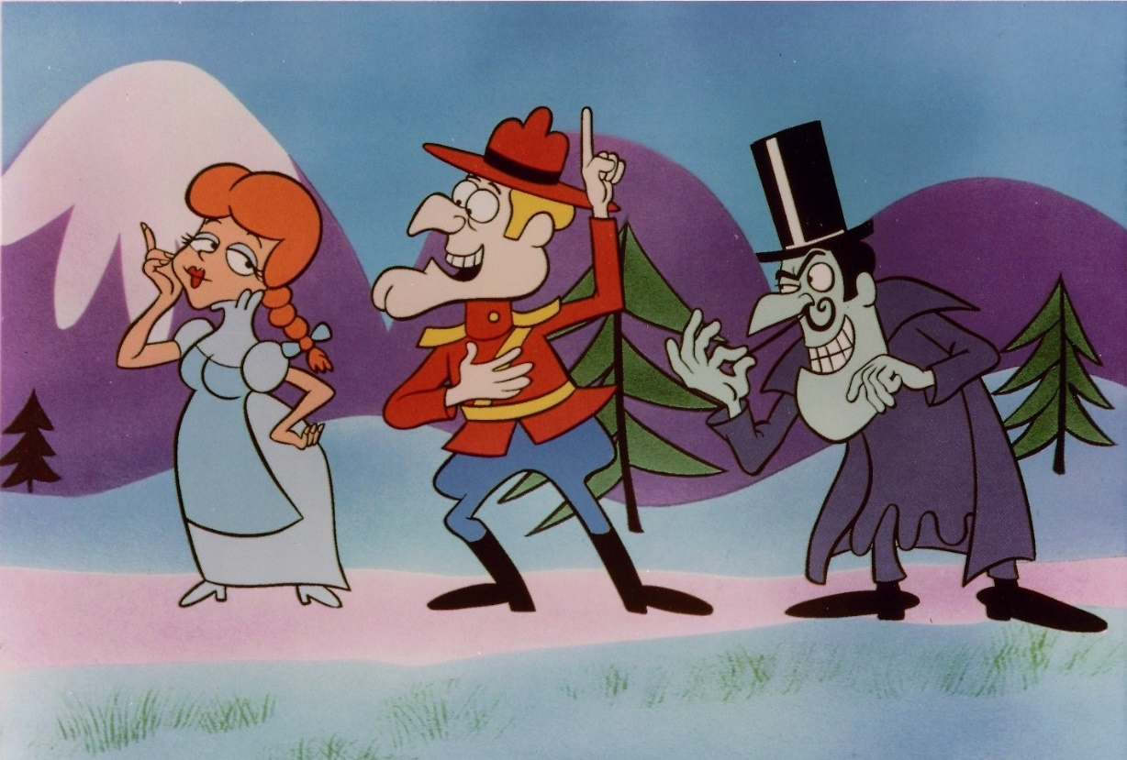
Consider your role in the conflict
Tips to Make You a Conflict Resolution Superstar
Notes:
Consider your role in the conflict. So where do you fit into the conflict? Did you start something you probably did not mean? Or even if you meant it, you should not have started it anyway. Maybe you are the victim, you just wanted to get your work peer-reviewed, and that started a holy war on whether the team should use spaces or tabs. Or maybe you came in to be the rescuer – and that can be good or bad depending on the purpose of the rescue.
Understanding where you fit in the conflict will take you further down the path of how to resolve the issue.

Slide 152

Organize a staff meeting
Tips to Make You a Conflict Resolution Superstar
Notes:
Let’s think about the peer review example I just said. Let’s assume you have two developers performing a peer review at one of their desks, and an all-out battle ensures whether to use tabs or spaces in their code. And for the non-developers in the room, that really does happen, although not as often as it used to. As a project manager, you hear what’s going on and see that this will get worse. Well, why not pull everyone into a collaboration room and discuss it. You probably will advert an actual conflict quickly, meaning that it will probably be worth a few moments to have these two developers made for the rest of the day.

Slide 153

Seek first to understand
Tips to Make You a Conflict Resolution Superstar
Notes:
Seek first to understand. Try to avoid jumping to conclusions. So many conflicts originate as simple misunderstandings, misinterpretations, and missed opportunities to clarify another’s intentions. You can mitigate or prevent so many of your daily conflicts by first seeking to understand those with whom you interact.
While simple, this mindset needs to be revised in our fast-paced workplaces. Workers can illuminate their understanding of a conflict by honing their listening skills, asking clarifying questions, and earnestly seeking other’s underlying interests. This simple action not only stops its escalation; it opens the doors for early and lasting resolutions as well.

Slide 154

Alert human resources
Tips to Make You a Conflict Resolution Superstar
Notes:
Alert human resources. If you are battling an issue as severe as workplace harassment, the problem might require intervention from someone higher up. When direct attempts and mediation are ineffective, you may have to pursue formal channels. Talk to your supervisor and human resources and follow your organization’s formal procedures for filing a complaint. Document the problem in writing, being specific about what behaviors occurred, when they happened, what impact they had, and what needs to be done to resolve conflict.
Really simple; no matter what level you are, you do not want to go it alone when it comes to workplace harassment. Doing so will cause you more grief than you would ever want.

Slide 155

Find a mediator
Tips to Make You a Conflict Resolution Superstar
Notes:
Find a mediator. Some workplace clashes turn into all-out battles worthy of a war movie. If you find yourself locked into a fight, it may be time for the groups to bring in a mediator.
You can introduce the conflict to a mediator formally or informally. An informal meeting with an objective person who all sides respect can help you talk through a problem without the formalities (and potential subsequent consequences) of formal mediation.
If an informal meeting does not put the issue to rest, you may need to contact a supervisor to help resolve the conflict. If you choose formal mediation, be sure of your best professional behavior. Do not attack your opponent. Present the conflict in objective terms and not as an emotional reaction to someone who happens to have an opposing viewpoint.
In a formal mediation, expect enlightenment. For example, a third-party observer may quickly point out failures in your argument that you could not accept from a co-worker. And that is the beauty of mediation – it helps bring the conflict to an objective, level playing field that is fairer for everyone.

Slide 156
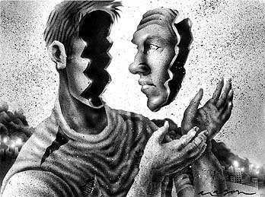
Be introspective
Tips to Make You a Conflict Resolution Superstar
Notes:
Be introspective. Conflicts arise in every workplace, and personality clashes abound in all of them.
Conflict is inevitable – plan for the future. In the aftermath of a conflict, take some time to consider how you manage your emotions.
How do you experience stress or anger?
What triggers set you off? How do you tend to react in the face of conflict?
What coping skills do you use?
Are they healthy to use? Then, use this self-awareness to make a plan for handling conflict better the next time one arises.
Each conflict is an opportunity for growth. Therefore, you should reflect and readjust after one occurs. Conflicts provide opportunities to better appreciate another perspective, clarify your own interests, strengthen bonds, and discover new ways forward. Internalizing and growing from these experiences allows you to face tomorrow’s difficulties with greater ease and effectiveness.

Slide 157
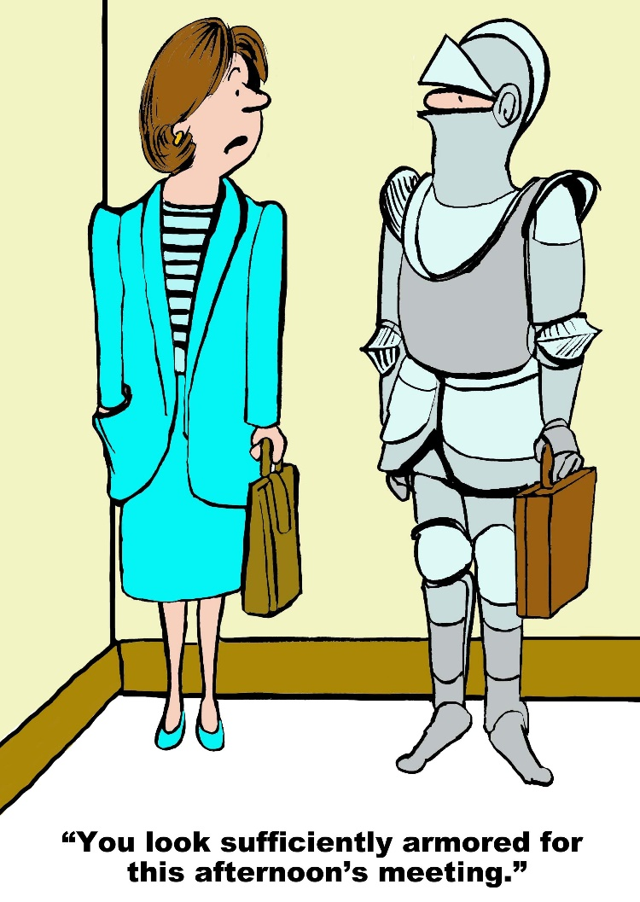
Expect conflict
Tips to Make You a Conflict Resolution Superstar
Notes:
Expect conflict. A conflict-free workspace would be a beautiful place indeed. However, it is only possible to avoid conflict partially. You have to learn to expect that conflict will become a part of your work life at some point.
The absolute imperative is learning to deal with conflict in a productive way. Do not let disagreements gather momentum and turn into major crises. Instead, address them as soon as possible. Resolve them instead of letting them fester.
Of course, for many people, avoidance or passive-aggressiveness is a more course of action. But fearing or avoiding conflict tends to make tense situations much worse.
As you work to manage the problem, ensure the conflict is resolved for all sides. If you feel triumphant, but your co-worker is deflated and upset or convinced that the outcome was unfair, there is a good possibility that the problem will flare up again. Learn better communication skills, though, and you will be a better employee and a happier person.

Slide 158

Everyone is different
Tips to Make You a Conflict Resolution Superstar

Slide 159
Thank You!
chadgreen@chadgreen.com
TaleLearnCode
ChadGreen.com
ChadGreen & TaleLearnCode
ChadwickEGreen

